Slide 1
Walkthrough
DATA STRUCTURE IN PYTHON
• Arrays
• Operation on Arrays
• Tuples
• Operation on tuples
• Lists
• Operation on Lists
• Dictionary
• Operation on dictionary
• Quiz and Exercise

Slide 2
Arrays
What are Arrays:
Array is a container which can hold a fix number of items and these items should be of the same type.
Most of the data structures make use of arrays to implement their algorithms.
Following are the important terms to understand the concept of Array.
Element− Each item stored in an array is called an element.
Index − Each location of an element in an array has a numerical index, which is used to identify the element.
Import array
from array import *
arrayName = array(typecode, [Initializers])

Slide 3
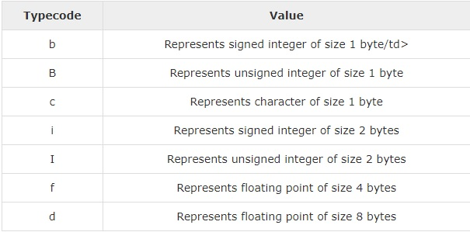
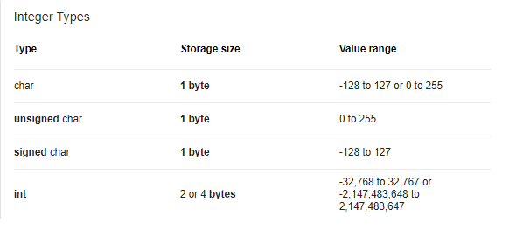

Slide 4
Operation on Array
Following are the operations on Arrays:
Accessing an array element
Inserting an element
Deleting an element
Searching an element
Updating an element
Append
Count
Extend
Insert
Search
Pop
Remove

Slide 5
Lists
List contain a mix of data-type
Lists in Python can be created by just placing the sequence inside the square brackets[].
Functions on lists :
Append
Clear
Count
Extend
Insert
Pop
Remove
Sort
del

Slide 6
Tuples
Tuple in python is ordered and unchangeable.
Tuples are written in round brackets.
The Datatype of tuples can be anything.
Tuples are immutable.
Following are the functions on tuple:
Concatenation
Reversing
Del
Max, min , len

Slide 7
Dictionary
Dictionaries store values in key and value format.
Following are the operations in dictionary:
Accessing a value
Changing a value
Length
Adding items
Pop
Del
Clear

